Slide 1
Introduction to Data Analysis in R - Day 1
Randi L. Garcia, PhD
DATIC Introduction to R Workshop
Session 1: June 7th and 8th
Session 2: June 21st and 22nd

Slide 2







Introductions
Me
Randi L. Garcia
Assistant Professor in Psychology and Statistical & Data Sciences at Smith College
Research interests
Data analysis software experiences
You…
Who are you, where are you coming from?
What brings you here? What do you hope to get out of this workshop?

Slide 3


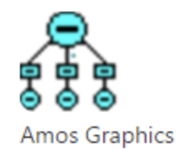







Why Learn to use R?
Many of the reasons you mentioned…
High cost of SPSS, especially for students
Reproducibility
My personal reasons:
It can do everything in one program
The R programming language versus SPSS syntax
Ability to create fully reproducible results, including automating results in manuscripts
Many teaching reasons

Slide 4
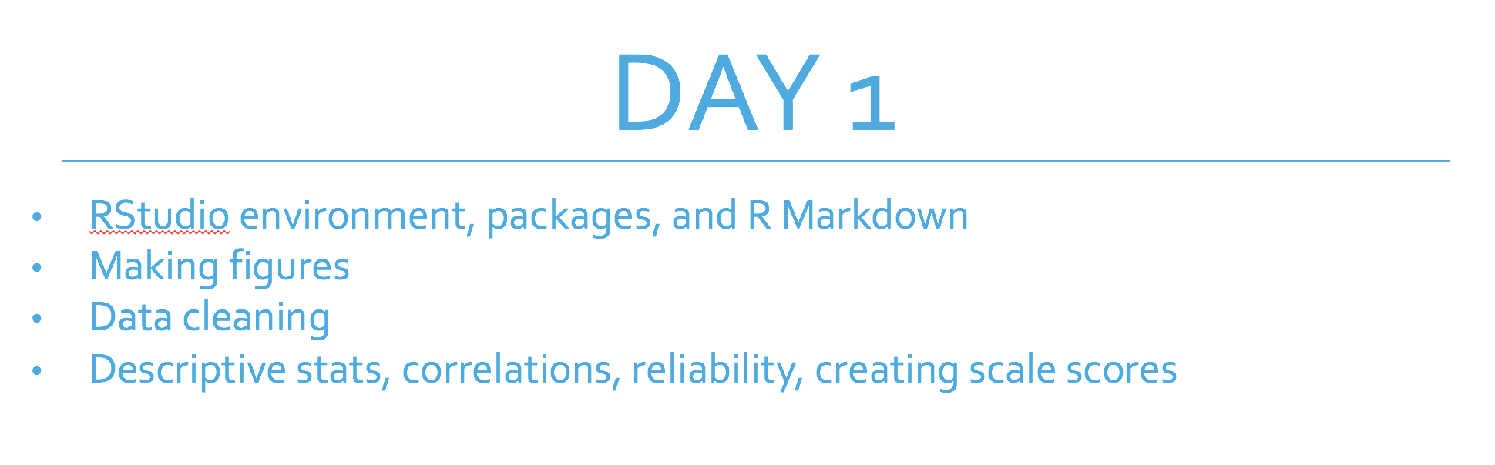
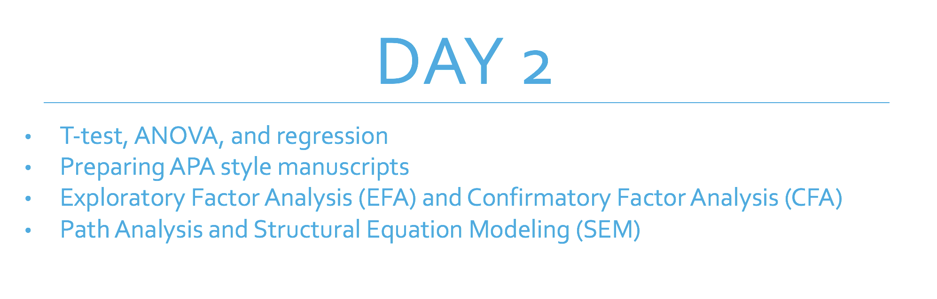
Schedule

Slide 5
Day 1
RStudio environment, packages, and R Markdown
Making figures
Data cleaning
Descriptive stats, correlations, reliability, creating scale scores

Slide 6
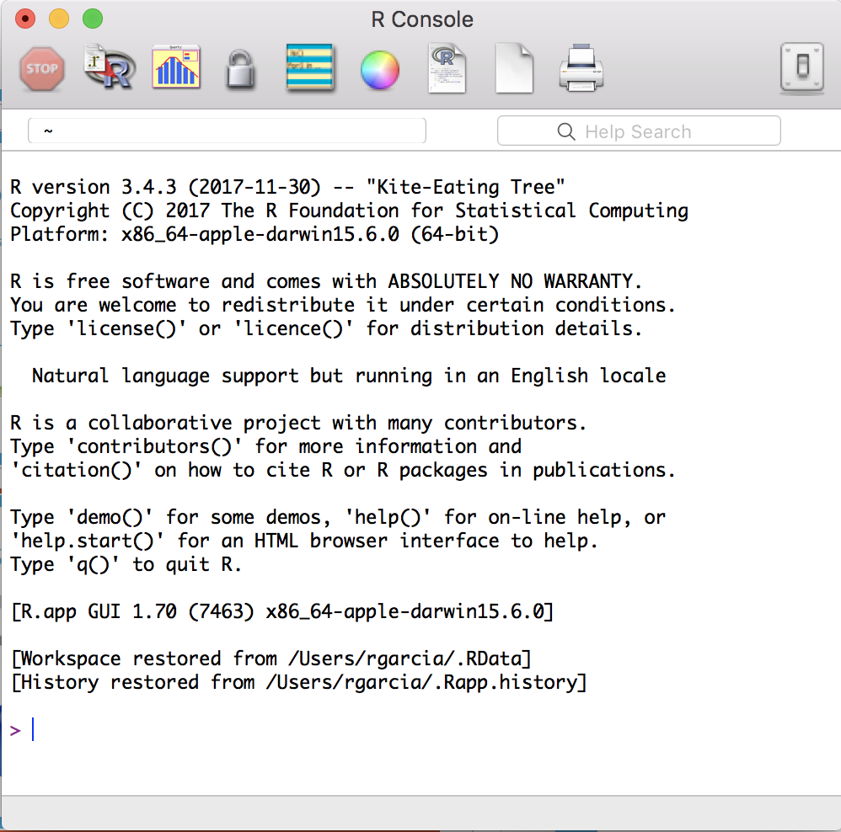

R and RStudio

Slide 7
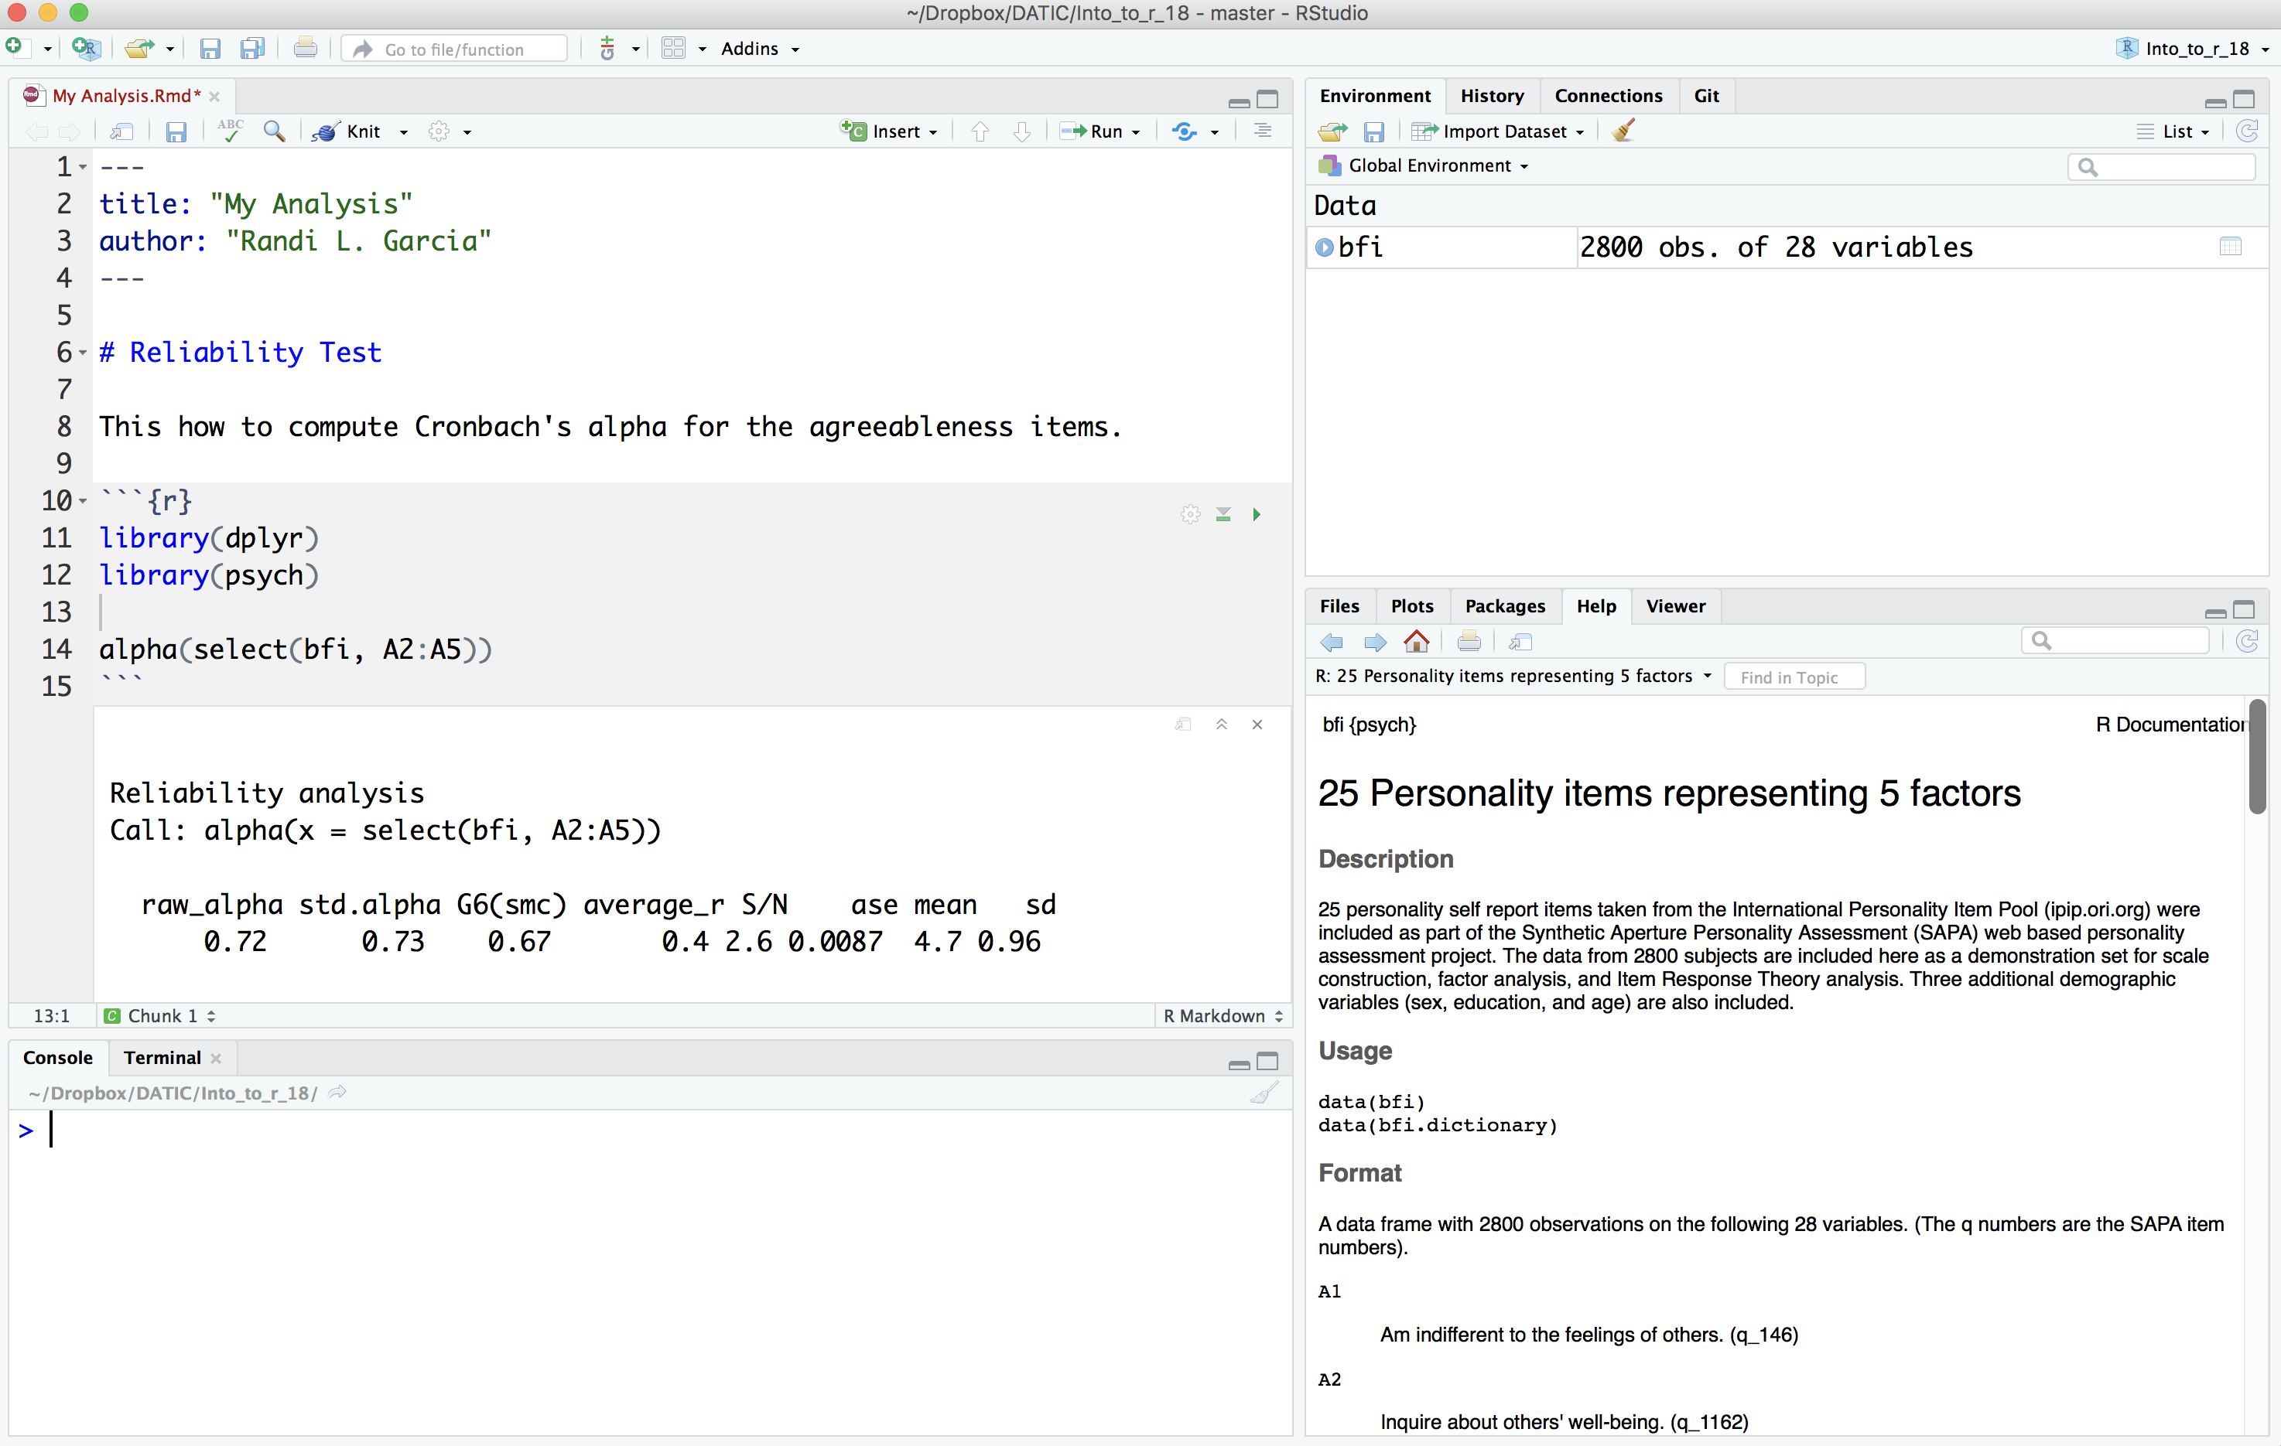
R and RStudio

Slide 8
Open R Studio

Slide 9
Let’s Use R Studio!
Bookmark this website:
bit.ly/intro-r-website
Download ALL materials, including R-code, here:
bit.ly/intro-r-materials

Slide 10
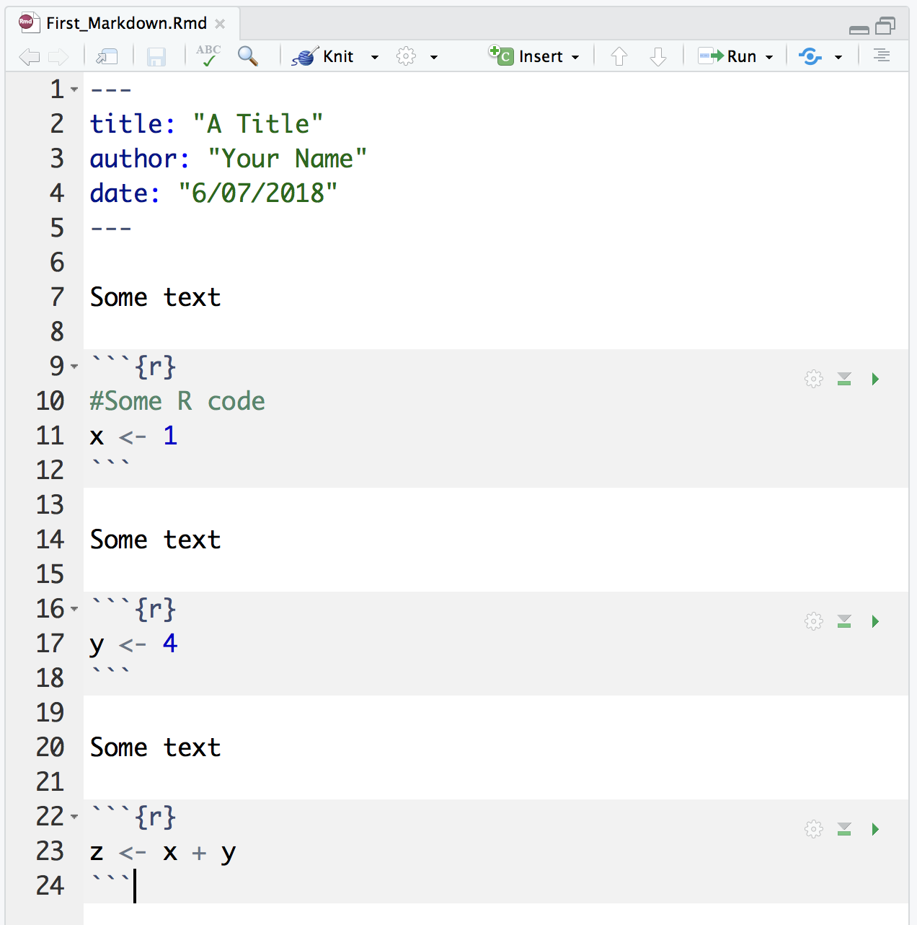
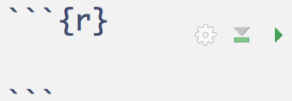
R Markdown is where your analyses live!
A file of type “.Rmd”
Starts with some basic information in the “YAML header”
A series of text and “code chunks”:
We will need to install some stuff…

Slide 11
R Markdown is where your analyses live!
A file of type “.Rmd”
Starts with some basic information in the “YAML header”
A series of text and “code chunks”:
We will need to install some stuff…

Slide 12
R Markdown is where your analyses live!
A file of type “.Rmd”
Starts with some basic information in the “YAML header”
A series of text and “code chunks”:
We will need to install some stuff…

Slide 13
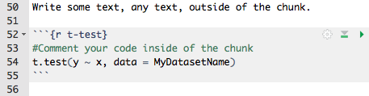
Anatomy of a Code Chunk
Run all of the code in this chunk
Giving your chunk a name helps find it later
”Bookends” to signify code is starting and ending
Chunk options (more on that later)
Run all of code in the chunks above
The R code goes between the bookends

Slide 14


R Studio
Intro_to_R.Rmd
packages_descriptive_stats.Rmd

Slide 15
Tidyverse

Slide 16
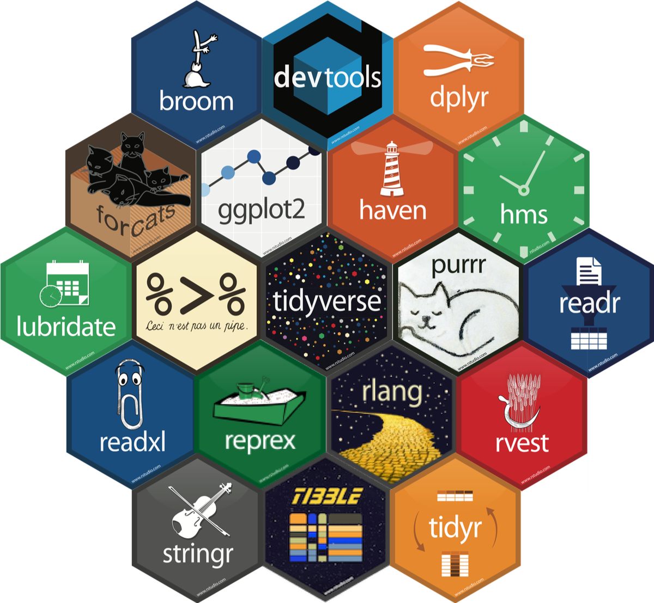

Which R?
There are >10,000 packages in R
This can feel overwhelming for new users
To make matters worse, “R people” are opinionated about which packages are “best”
There is NO consensus! Eventually you’ll be able to decide for yourself, for now, I’ll decide for you…
We are going to learn some of the tidyverse packages in this workshop
Hadley Wickham

Slide 17
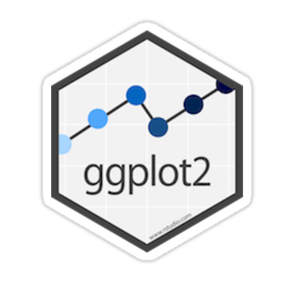
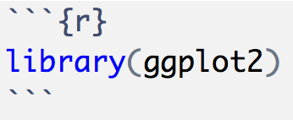
Making Figures with ggplot2
As with everything else, there are lots of ways to make figures in R
Base R
Lattice graphics
The ggplot2 package
We’ll be learning the ggplot2 package.
It makes beautiful visualizations
It’s popular so there is a lot of help on the internet and companion packages
It works well with all of the tidyverse packages

Slide 18
Ggplot2

Slide 19
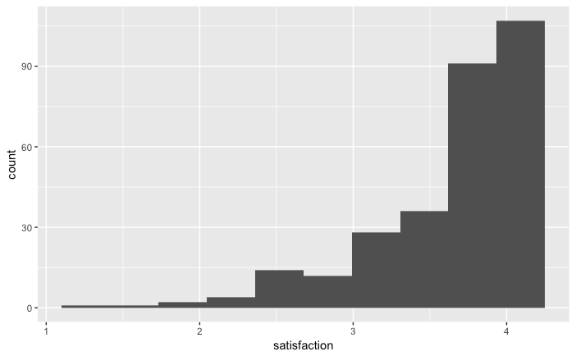
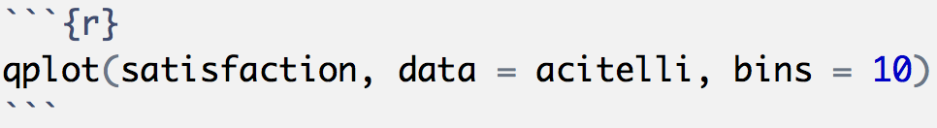
Making Figures with ggplot2
The easiest figures are made with the qplot() function
The q stands for quick!
Guesses which kind of figure you want based on the variable(s) type
Customize it!
It needs to know the data, but no dollar signs!

Slide 20
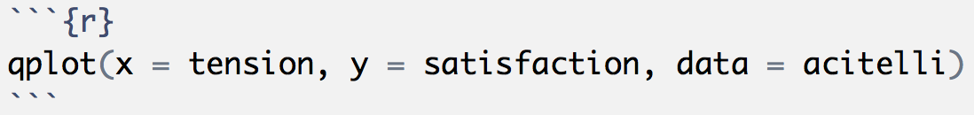
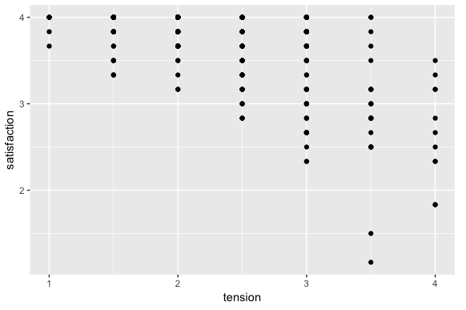
Making Figures with ggplot2
qplot: “Two numerical variables? Oh, you probably want a scatter plot…”

Slide 21
Making Figures with ggplot2
The qplot() function is good for quick visualizations
Good for probably 80% of what you’d want to do while analyzing data
But, you’ll use the ggplot() function for anything more involved, like for making figures for publication
The ggplot2 packages uses the “grammar of graphics"

Slide 22
Making Figures with ggplot2
We independently specify pieces of the graph using the “grammar of graphics”
Building blocks:
Data
Geometric objects (the actual things we’ll draw: points, lines, boxplot, histograms, etc.)
Aesthetic mappings (what and where we’ll draw: x-axis, y-axis, color, fill, shape, size, linetype, etc.)
Statistics (implied or specified computing to be done)
Scales (range of values, colors, or shapes)
Facets (the panes—there can be more than 1)
Guides (legends—what the humans see)

Slide 23
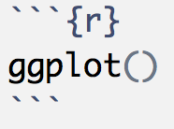


Slide 24
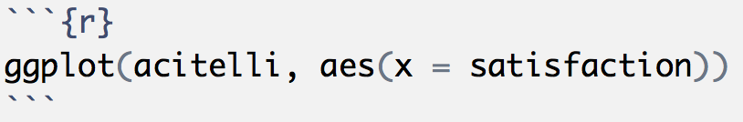
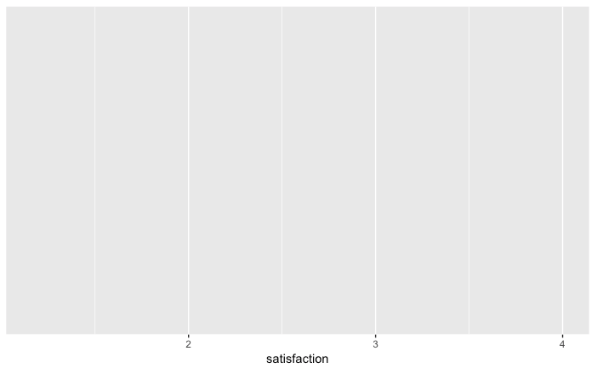
The data comes first
Where’s the stuff??
Specify “aesthetic mappings” with the aes() function

Slide 25
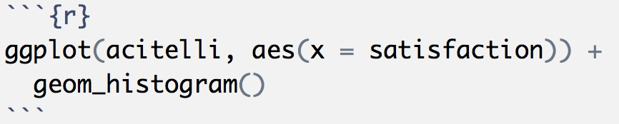
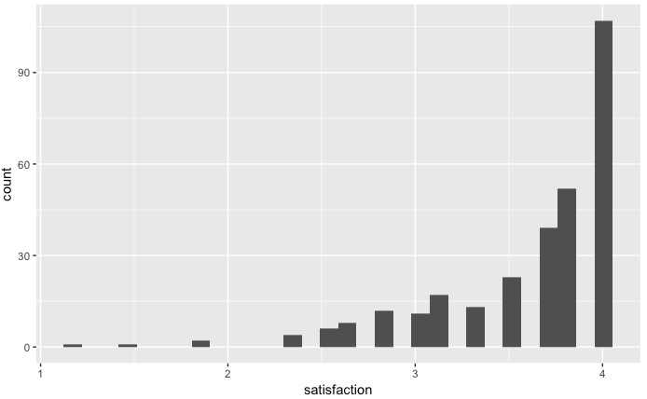
Gotta add some geom’s
Statistic
Geometric object

Slide 26
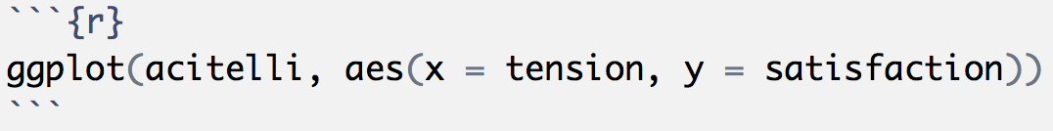
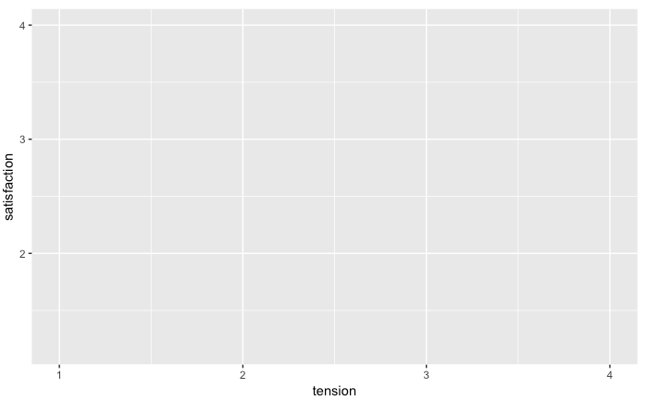

Slide 27
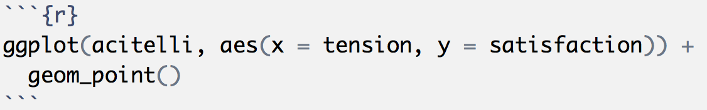
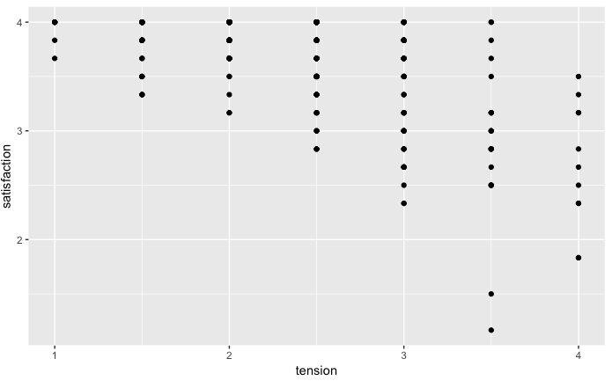

Slide 28
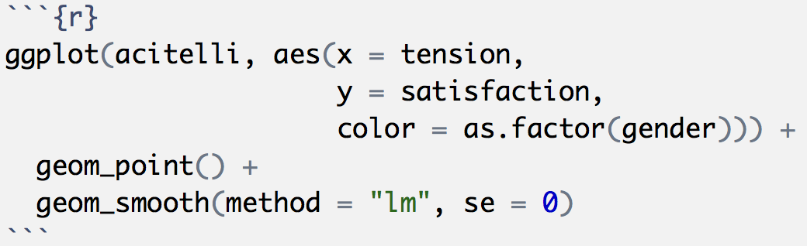
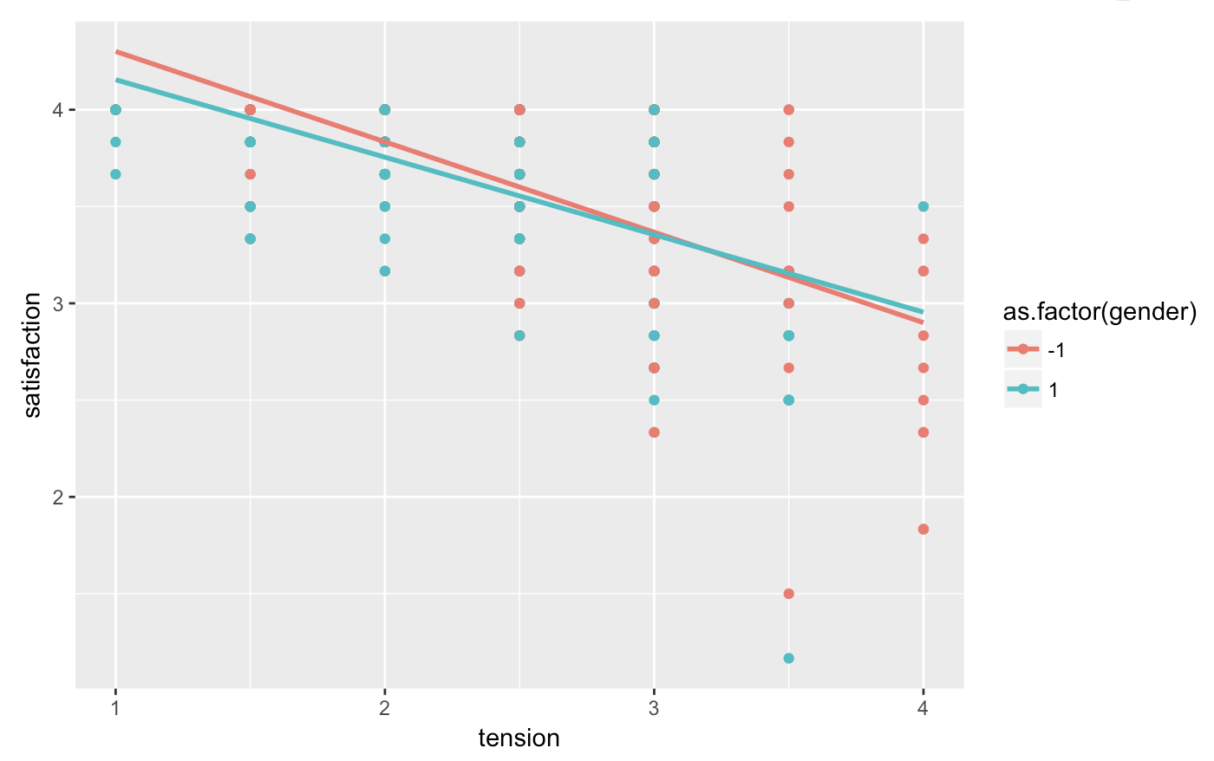
Map to color!
Layer on those geoms!
What do you think would happen if we mapped color to self_pos, a numerical variable?

Slide 29
R Markdown
Intro_to_ggplot2.Rmd

Slide 30
dplyr

Slide 31

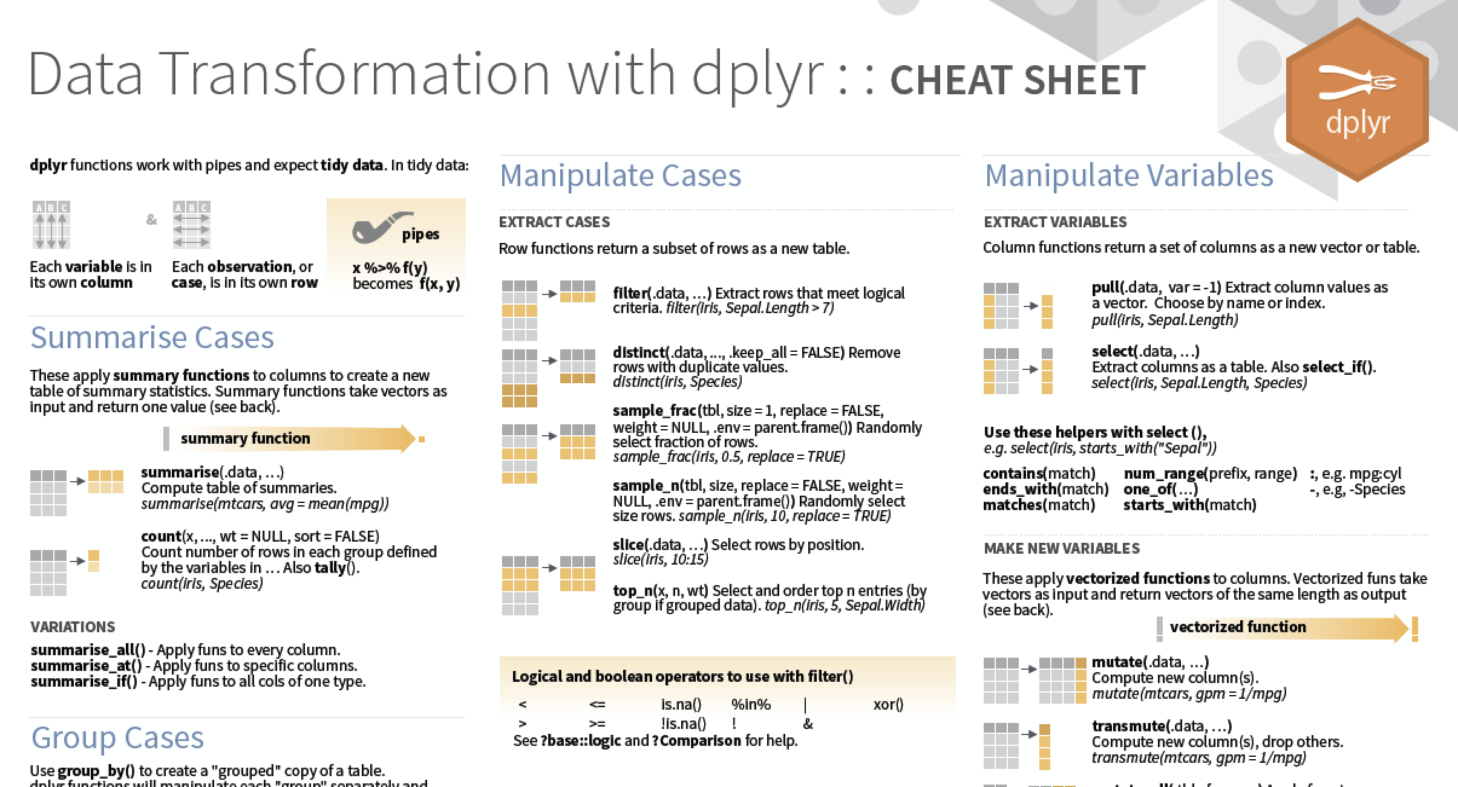
Data Cleaning
The package we’ll use for data cleaning is called dplyr, which is part of the tidyverse, also written by Hadley Wickham
Find all the cheatsheets here: https://www.rstudio.com/resources/cheatsheets/

Slide 32
Data Cleaning
The five data verbs
filter()
mutate()
arrange()
select()
summarize()
And also…
group_by()
rename()
full_join(), right_join(), left_join(), inner_join()
gather()
spread()

Slide 33
Data Cleaning
Each verb performs familiar operations on a dataset
Each function takes and dataset and returns a dataset
Verb | What is does | …in SPSS
mutate() | Creates new variables | COMPUTE (or transform in menu)
filter() | Filters for specific cases | FILTER (or select data in menu)
arrange() | Sorts using some logic | SORT
select() | Subsets for only certain variables | DROP
summarize() | Create a summary table | Descriptive statistics
group_by() | Groups dataset by a categorical variable | Like split file in menu

Slide 34

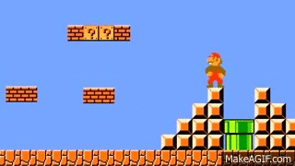
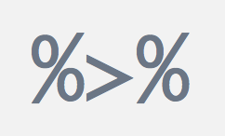
Data Cleaning
We will use the pipe operator to combine verbs!

Slide 35
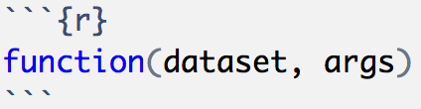
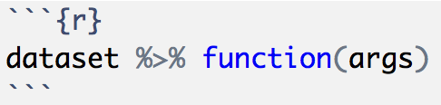
Data Cleaning
…is the same as:

Slide 36
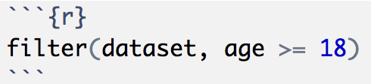
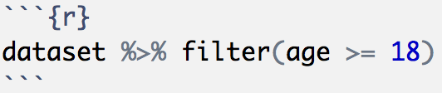
Data Cleaning
…is the same as:

Slide 37

Data Cleaning
Why the pipe!?!?
Let’s say we want to
Create a scale score, a depression index (bdi), then
Filter for only people 18 or older, then finally
Keep only a smaller dataset with just bdi and say, social support

Slide 38
Data Cleaning
Why the pipe!?!?
Let’s say we want to
Create a scale score, a depression index (bdi), then
Filter for only people 18 or older, then finally
Keep only a smaller dataset with just bdi and say, social support

Slide 39
Data Cleaning
Why the pipe!?!?
Let’s say we want to
Create a scale score, a depression index (bdi), then
Filter for only people 18 or older, then finally
Keep only a smaller dataset with just bdi and say, social support

Slide 40
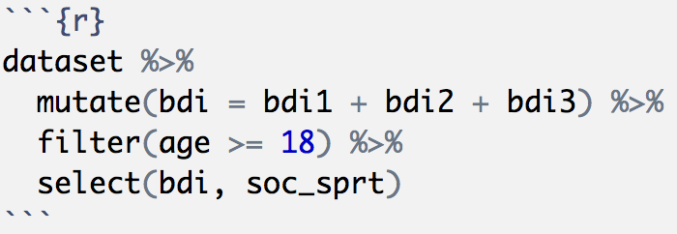
Data Cleaning
Instead of reading/writing:
We can write:

Slide 41
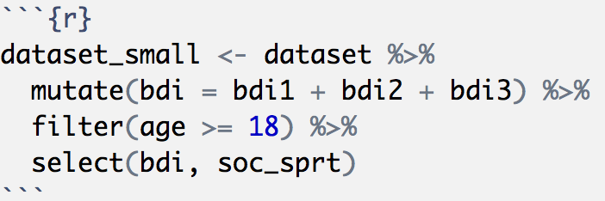
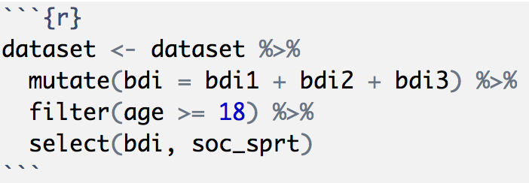
Data Cleaning
Save to a new object:
Or the same object

Slide 42
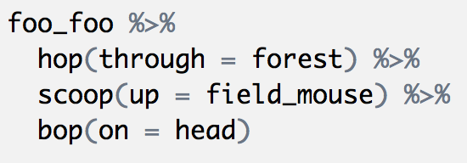

Little Bunny Foo Foo

Slide 43
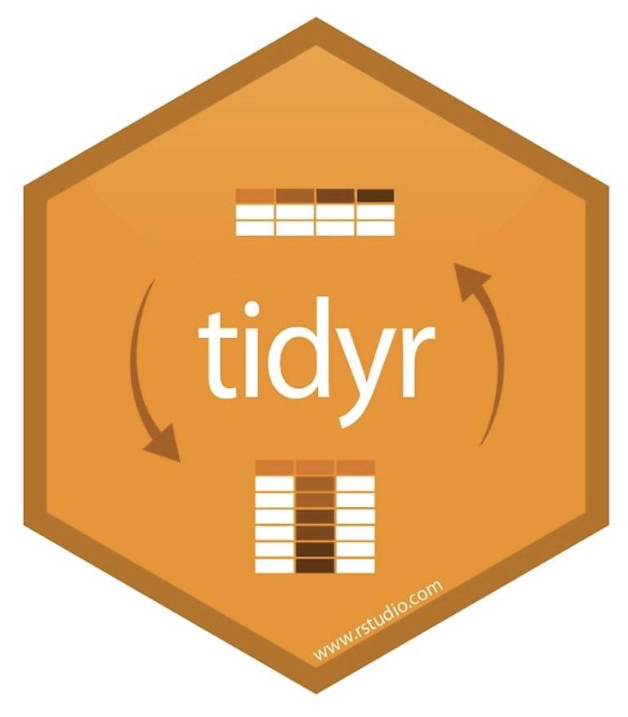
More Data Cleaning (Day 2)
There are also verbs for joining two tables (in dplyr)
Adding cases from another dataset
bind_rows()
Adding variables from another dataset
inner_join(), right_join(), left_join(), full_join()
bind_cols()
And verbs for transforming data from (in tidyr package)
Wide-to-long
gather()
Long-to-wide
spread()

Slide 44
R Markdown File
intro_to_dplyr.Rmd

Slide 45
forcats

Slide 46

Categorical Variables
Some stuff you’ll need from the forcats package:
fct_recode()
fct_collapse()
Categorical variables are called factors in R. The package name, forcats is an anagram for factors!
There’s tons of other stuff you can do with factors using this package—read the R for Data Science book for more detail.

Slide 47
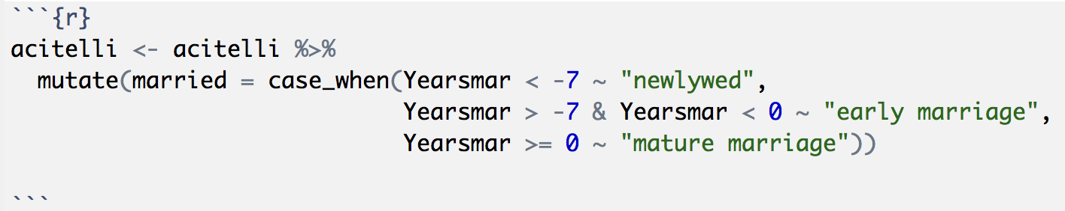
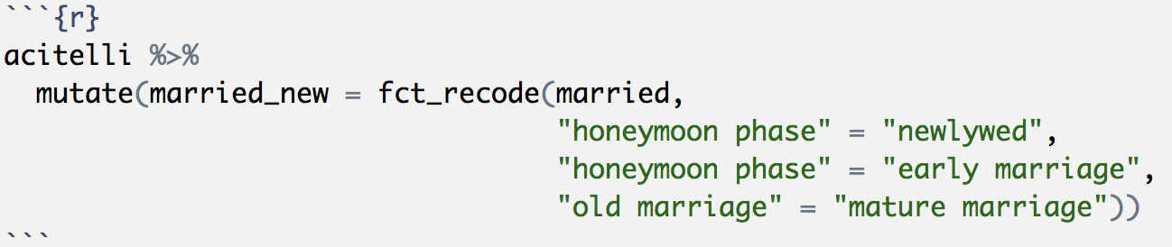
Categorical Variables
Recall that we made a categorical variable out of our years married variable.
We can use fct_recode(“new” = “old”) to change levels of existing factors

Slide 48
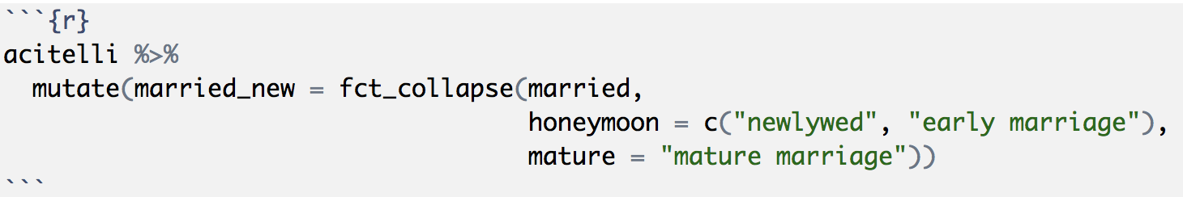
Categorical Variables
We can use fct_collapse() to be even more slick

Slide 49
Correlation, reliability, and t-tests

Slide 50
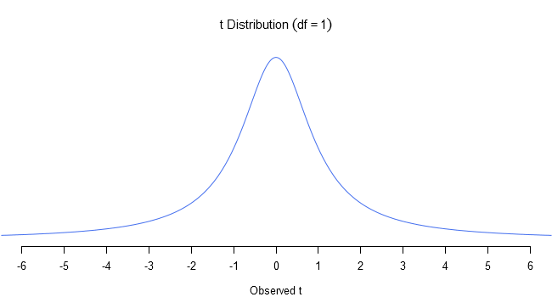
Correlation Matrices, Reliability, and t-Tests
For correlation matrices and Cronbach’s alpha we’ll use the package called psych
For t-Tests I recommend you use mosaic because it has the formula, then data, syntax (without needing dollar signs)

Slide 51
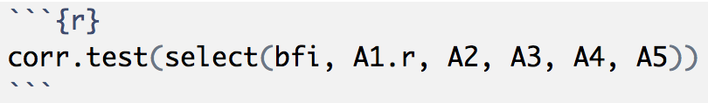
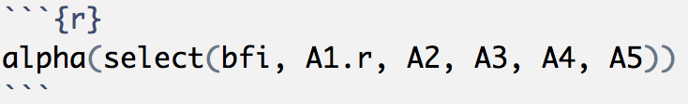
Correlation Matrices and Reliability
Correlation Matrix
corr.test()
I like to use this with select():
Reliability
alpha()
Also handy with select:
vars for matrix
items for alpha

Slide 52
Creating Scale Scores
It’s best to use the rowMeans() function from Base R.
Doesn’t quite have the same syntax, the data will need to be in the select() function.

Slide 53
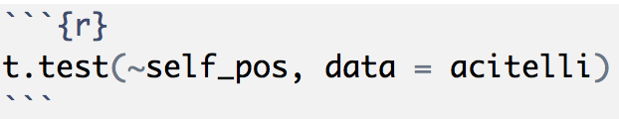
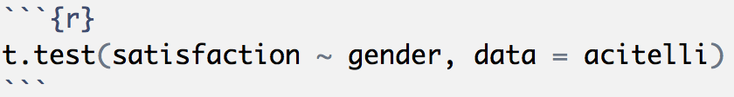
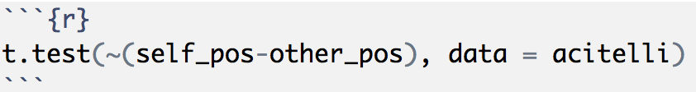
Student’s t-Tests (in mosaic)
One-sample
independent samples
paired samples

Slide 54
Function Masking
R is open source and anyone is welcome to contribute a package!
The package author decides on the names of their functions and there are bound to be redundant function names
Sometimes it’s by design
t.test() is a function in Base R
t.test() is a function in mosaic
Sometimes is an unfortunate coincidence
alpha() is a function in ggplot2
alpha() is a function in psych

Slide 55
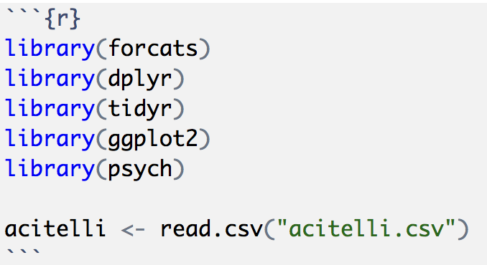
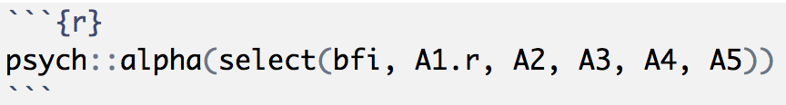
Function Masking
Solution 1: Always load psych after dplyr and ggplot2
Solution 2: Do what you want, but if you get errors, be explicit about which package you want

Slide 56
R Markdown File
cor_reliability_ttest.Rmd

